Slide 1
5- LES REPONSES …

Slide 2
Liberalization and financial difficulties are resulting in …
- More consolidation
- Alliances
- Joint-ventures
- Changes in M.H.Model.

Slide 3
- 5.1. ANSWERS

Slide 4
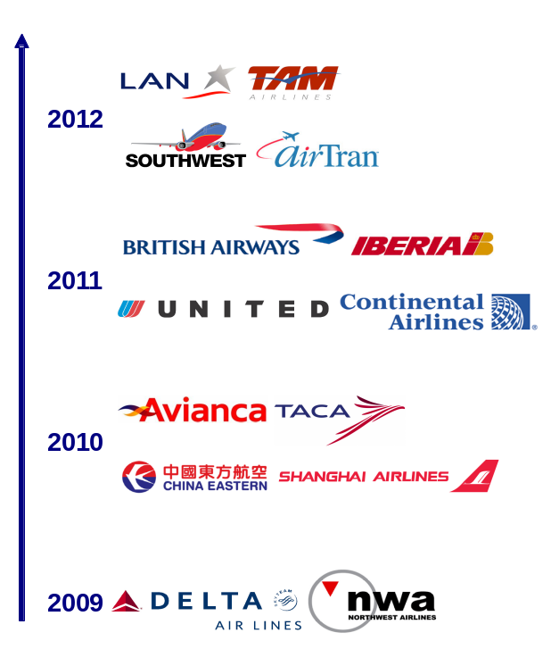
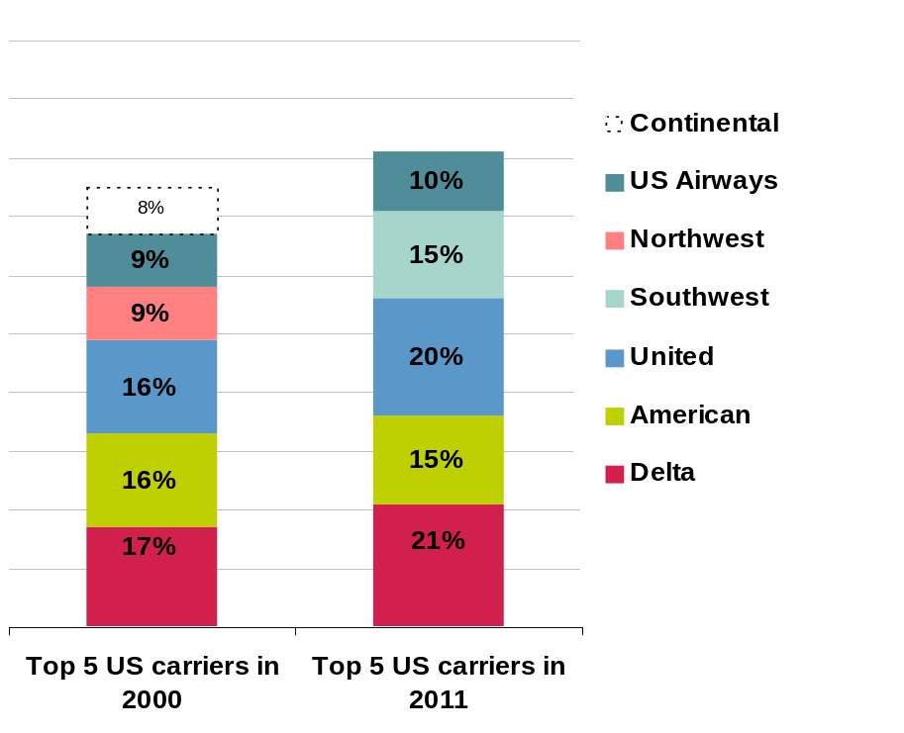
Consolidation is on-going everywhere
All continents are concerned by the consolidation
Consolidation on the American market is very advanced
SRS intra US - SKO Q3 2000 et 2011
  With mergers, capacity is rationalized
81%
66%
8%
- 4%
- 5%
  In China, the top 4 groups operate 95% of domestic flights
  In Latin America consolidation is also expanding, in a strong growth context
  In Europe, the 5 top groups only offer 45% of medium-haul capacity
Notes:
Consolidation of air transport has accelerated as a result of liberalization and successive economic crises. This movement will be almost complete in the U.S. when Southwest will acquire AirTran in 2012. To date, five major U.S. airlines account for 81% of ASK capacity on domestic routes. In China, Air China has taken control of Shenzhen Airlines, and China Eastern has taken over Shanghai Airlines. The four major Chinese airlines therefore represent 95% of capacity on domestic routes. The air transport sector in Latin America is also changing rapidly with the merger of Avianca and TACA and the proposed merger between TAM and LAN in a context of gradual liberalization and strong growth market.
In Europe, consolidation is also making progress, with the creation of the IAG Group (British Airways - Iberia) in 2011. However, the top five European players make up only 45% of medium-haul capacity, which still leaves the door open to new merger possibilities. TAP and Aer Lingus will probably be surrendered in the short-term by their respective state shareholders. In addition, SAS and Virgin Atlantic who do not wish to remain isolated, could also become part of a major European group in the short term.

Slide 5
- 5.2. ALLIANCES

Slide 6
Why Alliances?
Internal growth is limited
  Airports and air space congestion
  No hub possibilities out of own basis
  Commercial network costs
External growth is limited
  Control is not possible (U.S.A. : 25%; Europe : 49% )
  Traffic rights
  Financial challenges
<
<

Slide 7
States regulations were not favourable to links between airlines
…. industry consolidation is far from other sectors …
100%
Constructeurs
aéronautiques
No merger; poor synergies
Offer no more adapted to high yield expectations
80%
Boissons gazeuzes
Telecom
60%
Part de marché des 5 premiers du secteur
Constructeurs
automobiles
Ordinateurs
40%
Grande Distribution
Industrie pharmaceutique
Pétrole
Cies aériennes
20%
0%
0
200
400
600
800
1000
1200
1400
1600
Chiffre d’affaires du secteur (Md$)

Slide 8

Alliance: a “win-win” process.
3. Funding future growth
1. Revenue generation
Cash flow improvement
access to new markets
Profitability increase
Financial capacity secured
additional revenue
at marginal cost
2. Cost savings
joint purchasing
Better contracting
more efficient use of assets
(Trade and Corporate)
sales and distribution synergies
best practice transfer
Notes:
Larger scale and scope are an Economic Necessity.
Alliances today provide mainly commercial benefits through extended market access for airlines, and some cost savings through network coordination and joint purchasing. Mergers offer potentially more cost reductions from economies of scale, standardization (fleet and IT systems), and network optimization.
Potential drivers of cost reduction resulting from consolidation are as follows:
Labour cost : savings come from a reduction in ground staff in overlapping activities such as network management, sales an distribution, maintenance and other support services. Combined operations are expected to yield flight crew savings.
Fleet cost : twin hubs and larger fleet increase utilisation and flexiblity. In the longer term, rationalization of fleet should yield a reduction in maintenance cost and crew training cost.
Sales and distribution cost : much of the savings can be achieved through closely integrated alliances : sales structure integration and increased competitive position in all distribution channels.Additional merger cost reductions can be achieved through a centralized CRM, a unified GDS.
Other external costs : catering, ground handling and fuel cost would yield savings from leveraging the purchasing power and the network optimization of the merged airlines.
Cost savings from either a simple alliance or a full merger, are estimated by analysts to range from a mere 2% to a sizeable 12 %.

Slide 9
ALLIANCE FOR THE CUSTOMER
- “WORLD WIDE” NETWORK
- CODE-SHARING AND SCHEDULE COORDINATION
- BETTER FARES AND CONTRACTS
- GLOBAL “SEAMLESS” SERVICE FROM O TO D (Booking, Checkin, Bags)
- BETTER CONNEXIONS IN AIRPORTS
- COMMON LOYALTY PROGRAM
- COMMON FACILITIES (Hubs, lounges, desks, …)
- “GLOBAL SERVICE”

Slide 10
Alliance and network: AF/DL
INCREASE OF FREQUENCIES AND/OR
AIRCRAFT CAPACITY
AF + DL widen their offer without additional costs
BETTER ATTRACTIVITY
+
COST EFFECTIVENESS
50% TO 150% ADDITIONAL TRAFFIC ON A ROUTE ENABLING THE VIRTUOUS CIRCLE
1+1 = 8 !
16 000
POINT-TO-POINT TRAFFIC
+ CONNECTING TRAFFIC
TransAtlantic weekly O&D potential
X 4
}
1900
2200
DL ALONE IN ATL
AF ALONE IN CDG
AF+DL IN ATL+CDG

Slide 11
FFPs and Alliances: a cross-fertilization process
More
Opportunities
More
Attractive
Network
Customers
FFP
37
More
Passengers
More
Clients
Customer choice drivers
15
11
11
9
9
8
SCHEDULES
BRAND
AND IMAGE
CORPORATE
CONTRACTS
FFP
TRAVEL
AGENTS
FARES
PRODUCT
Source : AF in-flight survey

Slide 12
Alliances’ targets: customers’ opinion
Better global presence 4.08
Global FFP 3.56
Better scheduling 3.56
Lower fares 2.88
Less competition 2.16
Routes
Hub to hub 78%
Hub to non hub 25%
Non hub to non hub 9%
According to Industry’s executives (2004 interview)
}
Better service
More advantages
Not a big worry
}
Alliances = Hubs

Slide 13


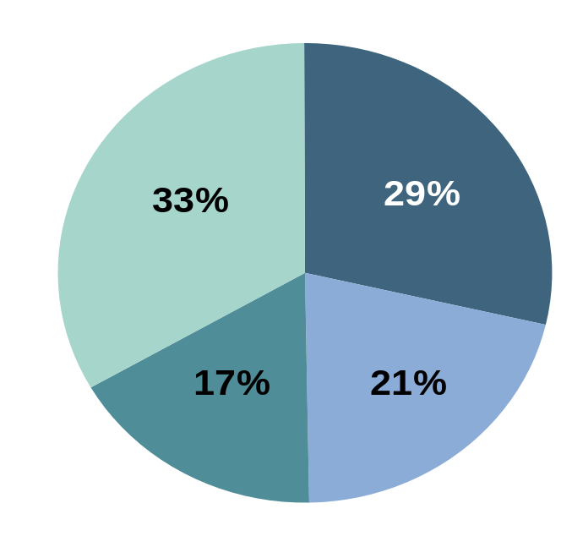




Airlines are getting stronger through partnerships and all the main alliances are expanding
The alliances are actively searching for new members
  The three main global alliances account for 2/3 of global traffic
  In 2010 many future integrations were announced
And non-aligned airlines are also launching commercial partnerships
  JetBlue, Alaska, WestJet and GOL are multiplying their interline and codeshare agreements
Forecast for 2012 of market share in traffic of the alliances taking
into account the latest announcements
Based on the RPK of WATS and total ICAO
Notes:
Like consolidation, the trend is in the growing number of partners for the 3 major global alliances. In 2011, Air India and Ethiopian will join Star Alliance, Kingfisher will go to oneworld and China Eastern and China Airlines will join Skyteam. In 2012, Air Berlin and Malaysia Airlines will join oneworld, TACA, Avianca and Copa Airlines will join Star, Aerolineas Argentinas, Middle East, Saudi Arabian and Garuda will join Skyteam.
In addition to these alliances, airlines are signing even more JV. Since September 2010 and the signing of the oneworld JV, 77% of the north Atlantic traffic is now covered by the Joint-Ventures of the 3 major alliances. On these existing JV, member airlines are now merging. Thus the JV gathering Star Alliance members should be supplemented by revenue from Austrian Airlines, bmi and Swiss from 1 July 2011. In addition, based on their strong existing partnerships, airlines are launching JV on new routes. In 2011, two JV were set up on the USA-Japan route: ANA-United-Continental and JAL-American. The transcontinental JV are beginning to get organized as well. Air france has signed a JV to China. Competition authorities just validated Lufthansa and ANA JV and IAG and JAL would also like to create a similar model. Finally the latest JV Delta - Virgin Australia and American - Qantas are extending the concept to the trans-South Pacific.
However some independent airlines keep signing bilateral agreements (interline and / or code-share) with carriers regardless of their membership in alliances, in order to improve their commercial offering. For example, JetBlue has recently signed agreements with LAN (Star), Virgin Atlantic (member of no alliance) and Emirates.

Slide 14






To support the strengthening and the expansion of the AFKL group network, strategic partnerships are key
?
?
?
SkyTeam should will have over 20 members by 2012
Joint-Ventures development
New partners by 2011-12:
Middle East Airlines,
Saudi Arabian Airlines,
Garuda Indonesia,
Aerolineas Argentinas,
China Airlines,
Shanghai Airlines,
China Eastern
NATL JV success
Europe – China JV implementation:
  Since November 1st with China Southern
  By 2012 with China Eastern
Notes:
Air France KLM network expansion will be supported by the development of the partnership strategy and by SkyTeam, which should count more than 20 members in the near future.
7 new comers will enrich SkyTeam Alliance network by the end of 2012 (Middle East, Saudi Arabian Airlines, Garuda Indonesia, Aerolineas Argentinas, China Airlines, Shanghai Airlines, and China Eastern). By 2012, thanks to the new Asian members, SkyTeam is likely to match Star Alliance currently more present in that part of the world. With China Eastern, SkyTeam will reach a share of 40 to 50 percent of Chinese traffic.
This enlargement of SkyTeam means more network opportunities, more frequent flyer agreements, extended commercial cooperation, which will turn into a stronger presence in all regions of the world.
The Group also keeps conducting its successful partnership strategy relying on Joint-Venture agreements in key markets, clearly benefiting from its experience with the North Atlantic JV. Next partnership will start by 2012 with China Eastern.

Slide 15



Alliances logo and slogan
Customer
Centric
Revolves Around You
Caring more about you
World Geography Reduced
Personal Power Increased
The Airline Network for Earth
Airline
Centric

Slide 16
- 5.3 JOINT-VENTURE

Slide 17
LAST STEP BEFORE MERGER
Europe < 49%
U.S.A. < 25%
MERGER
JOINT-VENTURE
F.F.P.
CODE-SHARE
S.P.A
INTERLINE

Slide 18

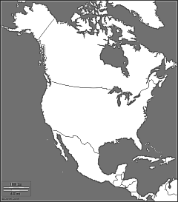
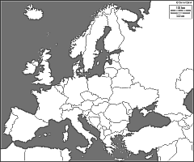

AF/DL/NW/KL/ AZ NORTH-ATLANTIC JOINT-VENTURE
“TRUNK ROUTES“
“BEYONDS”
USA/CAN/MEX ----- EUROPE
Notes:
rv

Slide 19
NATL JV
JV IS LIKE A BUSINESS UNIT.
NEEDS A.T.I FROM THE AERAS AUTHORITIES.
- GLOBAL PLANIFICATION OF THE NETWORK
- OPERATIONS AND CAPACITIES OPTIMIZED ON TRUNK ROUTES.
- COMMON AND OPTIMIZED PRICING AND COMMERCIAL POLICIES
- REVENUES AND COSTS SHARED.
- FACILITIES ARE MOSTLY SHARED.
- COMMERCIAL STAFF UNDER ONE ROOF IN EACH AREA.
- PROFIT (OR LOSS) OF THE UNIT SHARED BETWEEN THE MEMBERS.

Slide 20
JV “WINNING FORMULA”…
LESS COSTS
+
MORE REVENUE
+
LESS EXCHANGE RISKS
=
MORE PROFIT

Slide 21
Keeping Image and Identity
Joint Venture is not “Yalta”
A must “exist” in area B
B must “exist” in area A
A
B
“Home” area of Airline B
Joint Venture
“Home” area of Airline A
What does “Exist” mean?
- Brand?
- Marketing?
- Communication?
- Loyalty?
- Airports?
A
B

Slide 22
Mexican case: promoting 3 brands…
“One – Roof “ under
DL leadership
in Mexico
Mexico United states market
Mexico Europe market
Joint Venture
AF
DL
KL
DL

Slide 23


ALL ALLIANCES ARE IMPLEMENTING JOINT-VENTURES
The JV: supreme partnership stage, prior to a merger
  North Atlantic routes are covered by the 3 JVs of the 3 main alliances
  2 JVs have started operating on the transpacific route (USA – Japan) in 2011
  Transcontinental JVs between Europe and Asia are developing
  AIR FRANCE KLM is leading the process
  NATL JV is the first one and a success
  JV on China are on-going:
  with China Southern since November 1st
  with China Eastern by 2012

Slide 24
5-4. CHANGE IN M.H. MODEL?

Slide 25
CONVERGING MEDIUM-HAUL MODELS?
“MAJOR”
Cost
Product Evolution
L.C.C.subsidiary
“MAJOR”
Simplified product
Attractive fares
Price Advertising
Growth = necessity
New consumers
Additional revenues
VALUE FOR CONSUMER
E-services
GDS
LOW-COST
More services
Price dropping
LOW-COST
Product

Slide 26
6- NEW CHALLENGES

Slide 27

Air transport: rapid changes are occurring
Global economic growth in 2-speed world
Customer behaviour evolution
Fuel price volatility
Consumer right protection
Taxation will impact airlines costs in the future
Environmental regulations strengthen
Notes:
Emerging countries confirm and strengthen their leading role in the post crisis economic growth, and the radical change in consumer behaviour accelerated by the crisis seems to stay: customers are increasingly sensitive to the balance between what they pay and what they get. Meanwhile, additional pressure is brought by other factors conditioning air transport development:
Oil and fuel price volatility makes airlines business planning highly uncertain,
Emerging countries grow faster than developed world,
Customer rights are increasing protected by legal frameworks, enforcing airlines even more to build their operational reliability ,
The planned inclusion of air transport inclusion in the EU Emission Trading Scheme in 2012 could put additional pressure on the competitive position of the EU airlines,
Budget deficits of governments enforce new forms of fiscal creativity, resulting in higher levels of taxation for European airlines.

Slide 28



Taxation and Passenger Protection policies may jeopardize the competitive position of EU airlines
Increased pressure on governmental budgets and environmental awareness stimulate fiscal creativity
The EU is working on new regulations to protect passenger rights, imposing increased costs on airlines
Transit charges
Fuel
Noise
VAT
Security
This puts additional pressure on air transport to become less vulnerable to external events
ETS*
Aviation sector included in ETS system per January 2012
70% of 4.2 € bn yearly ETS related costs ( 2012-2020) are paid by European carriers
*ETS: Emission trading Scheme
Notes:
Increased pressure on governmental budgets and growing environmental awareness stimulate fiscal creativity, aviation being a clear target, with no end in sight: ticket taxes in EU countries amount yet to €5 billion in 2011, and UK and Germany are waiting for € 8.5 billion ticket taxes revenues in 2015 according to AEA estimations…
UK Air Transport Passenger Duty remains currently the largest single aviation tax in the world with GBP 2.9 billion, and Germany implemented from January 2011 a departure tax worth € 1 billion annually.
Although Aviation fuels global trade, which stimulates economies and contributes to restore government budgets, it is still seen as a fiscal resource in many cases, ignoring its adverse economic impacts: as an example, the Dutch departure tax which was introduced in 2008 was designed to collect € 312 million annually. It was repealed in July 2009, because it was costing the economy € 1.2 billion ( SEO Economisch Onderzoek report).
The European Union plans to include the aviation sector in the Emission Trading Scheme per January 2012. EU ETS is not only expensive (as it would lead to an extra cost of € 38 Billion for the period 2012-2020, source AEA), but is flawed as a result of institutional deficiencies, being vulnerable to legal challenges, and penalizing European airlines within the Industry.
Regarding Passenger protection policies, the rules on passenger rights are likely to evolve towards more severity, in Europe as well as in the USA: long delay tends to be assimilated to a cancellation, which itself is assimilated to denied boarding ( Reg EC 261/2004 + European Court of Justice 19/11/09), except under extraordinary circumstances, which appear more and more limited…Today, according to AEA estimates, this would translate into a yearly cost of €4 billion or an average cost of 5€ per passenger flown.
Governmental policies lay behind in providing the way to reduce delays: the ATM (Air Traffic Management) reengineering is not yet done (Single European Sky), and infrastructure congestion weights on punctuality of European Air Transport.

Slide 29
7- Hubs

Slide 30
7-1. CONNECTING ALL CITIES TO THE WORLD IN OPTIMIZED CONDITIONS

Slide 31
DIRECT FLIGHTS VERSUS HUBS
The best product between two Cities is, obviously :
- direct flight
- with several daily frequencies
- with an adapted schedule.
- with large and comfortable aircrafts.
But only few cities present enough market.
Hubs are the solution .

Slide 32
The Hub, an efficient system: the exemple of CDG.
responds to customer demand: more destinations, more frequencies, more attractive prices.
provides regional cities with an access to the rest of the world.
responds to economic requirements: aircraft equipment density, optimization of resources, profitability .
limits environmental impact: concentration at a point but optimizing control and noise reduction .

Slide 33
The hub and spoke system
A
A
X + Y + U
U
X
Y
H
H
X + W + Z
Z + V + Y
W
V
B
C
B
C
Z
4 airports
6 O&D markets
3 lines
4 airports
6 O&D markets
6 lines
Less Traffic per Line More

Slide 34
A value-making dynamic, for both customers and airlines...
The Hub Vertuous Circle
frequency increase
and/or aircraft size increase
more attractive and
less expensive services
point to point traffic 
connecting traffic 

Slide 35
Small markets get an access to the rest of the world
Connecting passengers (= 50%)
LUANDA :
1.9 passenger per flight
JOHANNESBURG :
0.5 passenger per flight
PAU
CDG
MOSCOW :
0.2 passenger per flight
MUMBAI :
0.1 passenger per flight
Point to point traffic ( = 50%)
Etc…, Etc...
Pau : 140 000 residents; 700 km from Paris; 3 daily flights to CDG.; 7h20, 11h00, 16h10.

Slide 36
Maximum amount of traffic with a minimum of resources: density economies
Madrid
1 O&D combination
Paris
New York
3 O&D combinations
Madrid
Paris
Los Angeles
Cincinnati
Madrid
57
O&D combinations
Mumbay
28 long-haul departures
Paris
- -
Atlanta
Marseille
Los Angeles
Bordeaux
- -
Cincinnati
61 medium haul arrivals &
28 long haul departures
1 797
O&D combinations
Madrid
Mumbay
Dublin
Paris
- -
Tel Aviv
Bank #2
MH-LH
Atlanta
Bank #2 = medium-haul arrivals from 8:50 to 9:30 and long-haul departures from 10:15 to 11:00 – Summer 2010
Notes:
Ainsi, la deuxième vague au hub de CDG, organisée autour de l’arrivée de 61 vols moyen-courriers et du départ de 28 vols long-courriers, offre 1 797 combinaisons possibles en moins de deux heures avec seulement 89 avions

Slide 37
Collecting smaller flows in order to reduce unit costs
... allowing to save on costs and to cut CO2 emissions
Economic impact of aircraft capacity and configuration
A 330
Base 100
135
There is a 30% gap in terms of unit cost between an A380 and an A330
130
- 30%
125
120
Seat unit cost *
115
110
A 380
105
100
320
420
520
620
720
820
Number of seats per aircraft (in economy seat equivalent)
*Tri-class equipment – Based on a 5000 Nautic Miles stage length
Notes:
En combinant les flux de trafic en correspondance et ceux de point à point, on se donne la possibilité d’augmenter plus rapidement notre offre.
Une augmentation vertueuse des fréquences :
parce qu’au-delà d’une part en fréquences de plus de 50%, notre part de marché croît plus que notre part en fréquences ;
parce qu’en augmentant nos fréquences, nous améliorons sensiblement la qualité de notre produit et en conséquence notre recette unitaire (ce sont les hommes d’affaires, notre haute contribution, qui recherchent le choix horaire) ;
enfin, parce que la montée en fréquences sur une ligne donnée permet de mieux utiliser les moyens sur le bout de ligne .
Une augmentation vertueuse de la taille des avions :
Le module est un facteur primordial de productivité dans le transport aérien. Entre un A330, entrée de gamme de notre flotte long-courrier, et le futur gros porteur A380, l’écart sur le coût au siège est de près de 30% !
On comprend aisément que ce système, bien exploité, permet d’amorcer un mécanisme vertueux :
→ en baissant les coûts unitaires - on peut être compétitif sur les prix – et donc développer le trafic, et ainsi de suite…

Slide 38
7-2. HUBS STRUCTURE: CDG.

Slide 39
Synchronized and condensed waves of arrivals/departures to optimize connections,while remaining attractive for point to point travellers
Long-haul
arrivals &
medium-haul only departures
Medium-Haul arrivals &
long-haul departures only
CDG hub banks structure
Pl 1
Pl 2
Pl 3
Pl 3bis
Pl 4
Pl 5
30mn
3:15
3:00
2:40
3:00
4:20
6:10
9:30
15:10
18:10
22:30
Prime Time arrivals from Europe
Prime Time departures to Europe
Notes:
Synchronized and condensed waves of arrivals/departures to optimize connections

Slide 40
Planning of a MH/LH bank
LONG HAUL ARRIVALS
MCT = 60'
LONG-HAUL DEPARTURES
MEDIUM HAUL ARRIVALS
MEDIUM-HAUL DEPARTURES
45'
5'
45'
MCT = 60'
MCT = minimum connecting time

Slide 41
The hub structure is driven by the Medium Haul network
6 BANKS MODEL
STATION XXX
NIGHT STOP
PRIME TIME
PRIME TIME
CDG
7^{h15}
12^{h30}
18^{h15}
B1
B3
B4
NIGHT STOP
STATION
XXX
PRIME TIME
PRIME TIME
20^{h30}
22^{h00}
CDG
9^{h30}
15^{h00}
B2
B3bis
B5

Slide 42
There are six banks per day in CDG
Only
LH ARRIVALS &
MH DEPARTURES
Only
MH ARRIVALS &
LH DEPARTURES
B1
B2
B3
B3bis
B4
B5
6:10
9:30
15:10
18:10
22:30
PRIME TIME ARRIVALS FROM EUROPE
PRIME TIME DEPARTURES
TO EUROPE

Slide 43
The CDG Hub banks
Medium Haul Arrivals
5/10 mn
Medium Haul Departures
Long Haul Arrivals
Long Haul Departures
CHIMNEY
45 min
45 min
BANK N°1
06:10
07:15
BANK N°2
08:35
09:30
09:35
10:30
BANK N°3
11:35
13:30
BANK N°3bis
14:25
15:10
15:25
16:10
BANK N°4
17:15
18:10
18:15
19:10
BANK N°5
22:20
23:20

Slide 44
7-3. HUB POTENTIAL

Slide 45
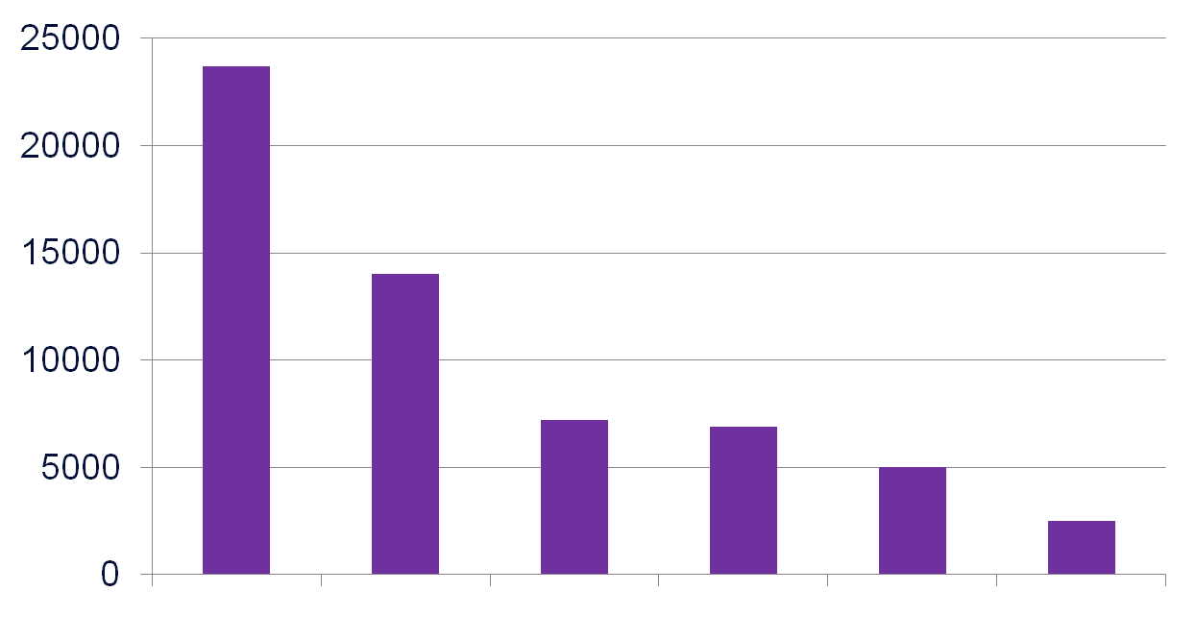
HUB POTENTIAL
NUMBER OF WEEKLY CONNEXIONS M.H./L.H. WITHIN 2 HOURS
AF/CDG LH/FRA BA/LHR KL/AMS SR/ZRH IB/MAD
Summer 2008

Slide 46
Link between frequencies and market share
Source : deregulating the Airlines - E. Bailey, DR Graham, DP Kaplan
100
80
60
Market share
(number of pax %)
40
20
0
Number of frequencies

Slide 47
Link between unit revenue and market share
US cents/RPM
20
United
Piedmond
16
Delta
Republic
12
Northwest
Western
American
8
TWA
Pan Am
4
0
14
20
26
32
38
44
50
Average market share (%)
Source : ATA et Boeing

Slide 48
7-4. HUB COMBINATION

Slide 49

Coordination between AF and KL hubs highly improves the AF KL offer for international trips
38 unique
destinations
Jakarta
AMS
“shuttle”:12 Dailys Flights
Hong-Kong
Madrid
33 common destinations
PAR
54 unique
destinations
Bangalore
March 2010 – http://corporate.airfrance.com

Slide 50
Strong advantage against competition.
On 182 destinations* Europe/L.H. flown by A.E.A airlines
British Airways: 83 destinations soit 46%
Lufthansa + Swiss : 81 destinations soit 44%
Air France : 80 destinations soit 44%
KLM : 64 destinations soit 35%
AF+KL
= 113 destinations
soit 62%
Competition is a « hub competition »
CDG and AMS
* vols operating+mkt programme S2006

Slide 51
... And a powerful combination.
overlaps contraints
5
47 uniques
Horaires
complémentaires
26
overlaps à résoudre
2
32 communes
35 uniques
Des destinations complémentaires
(Long-courrier)
Des horaires complémentaires
Destinations uniques et communes décomptées en escales

Slide 52
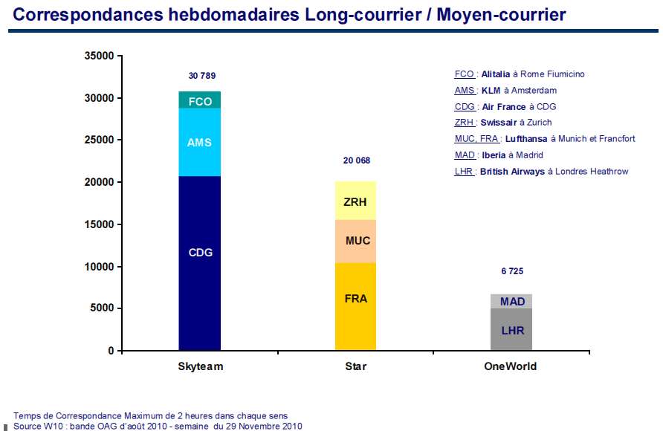
Alliance make stronger the “hub system”
Weekly connexions M.H./L.H. within 2 hours
Weekly connexions M.H./l.H. within 2 hours
42
25
7

